Slide 1
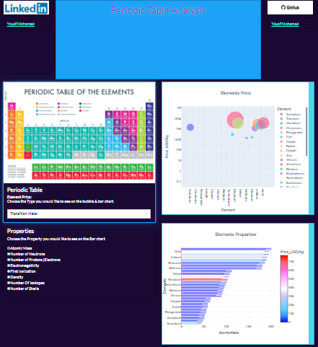
Periodic Table Analysis
Design Elements Infographics

Slide 2
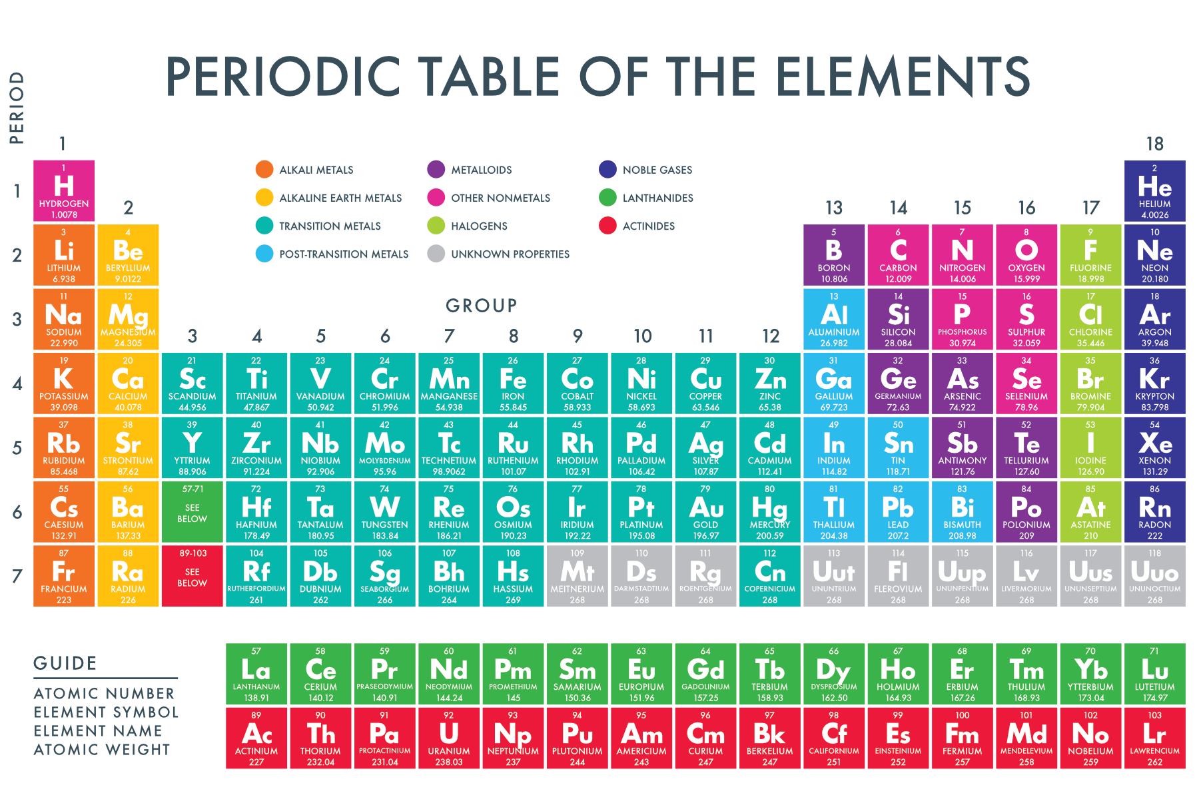

Slide 3
Table of content
1.About Periodic Table
2. Data Gathering
By Web Scraping
From Kaggle
3. Data Merging
4. Exploratory Data Analysis (EDA)
Understanding the Dataset
Data Profiling
5. Data Cleaning
1. Columns Format
2. Drop Un-wanted columns
3. Nall values Handling
4. columns Name Handiling & Arrangement

Slide 4
Table of content
6. Data Analysis & Visualization
1. Phase of each Type of Metal Elements
2. Types of Metal Elements
3. Correlation of Features
4. Metalic Elements: Features highly correlated With it's Type
5. Transition_Metal Analysis
7. Dash App

Slide 5
About Periodic Table
Elemental Properties: Explore the physical and chemical properties of elements, such as atomic mass, electronegativity, and density.
History of Discovery: Learn about the historical context and scientists involved in the discovery of various elements throughout the centuries.
Mendeleev's Periodic Law: Understand Dmitri Mendeleev's contribution to the development of the periodic table and his periodic law organizing elements by atomic mass.
Modern Periodic Table: Explore the structure of the modern periodic table, organized by atomic number and grouped by similar chemical properties.
Periods and Groups: Understand the significance of periods (rows) and groups (columns) in the periodic table and how they relate to electron configuration.
6.Transition Metals: Delve into the properties and applications of transition metals, which occupy the central block of the periodic table.
7.Noble Gases: Learn about the inert gases in Group 18, known as noble gases, and their unique lack of reactivity.
8.Isotopes and Atomic Structure: Explore the concept of isotopes, variations of elements with different numbers of neutrons, and their impact on atomic structure.
9.Periodic Trends: Investigate trends such as atomic radius, ionization energy, and electronegativity, which vary predictably across the periodic table.
10Elemental Abundance: Understand the distribution and abundance of elements on Earth and in the universe.

Slide 6
Data Gathering
1.By web scraping
2.From Kaggle

Slide 7
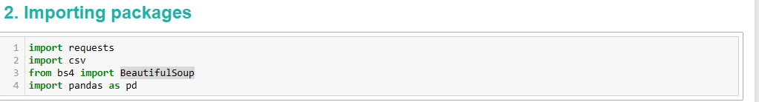
Data Gathering
Collecting data about the prices of element in the periodic table from URL: http://www.leonland.de/elements_by_price/en/list using BeautifulSoup package
Data from Kaggle: https://www.kaggle.com/datasets/psycon/periodic

Slide 8
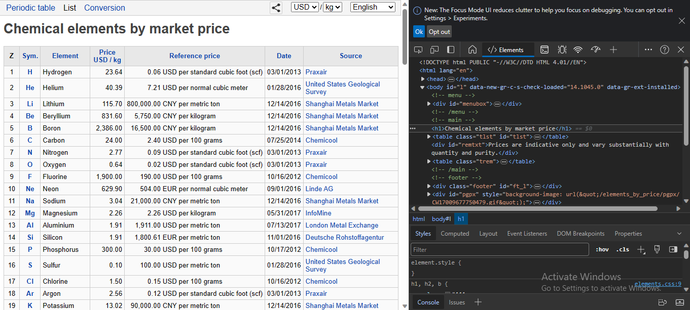
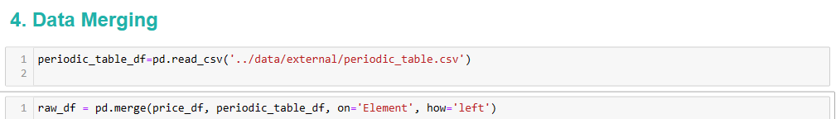
Elements Price Gathering By Web Scraping

Slide 9
EDA & Cleaning
1.Exploratory Data Analysis
2.Data Cleaning

Slide 10
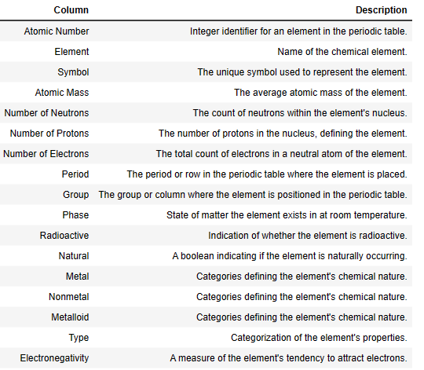
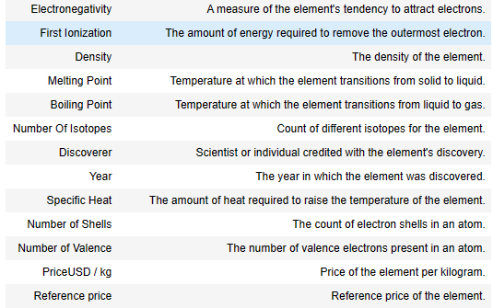
Exploratory Data Analysis

Slide 11
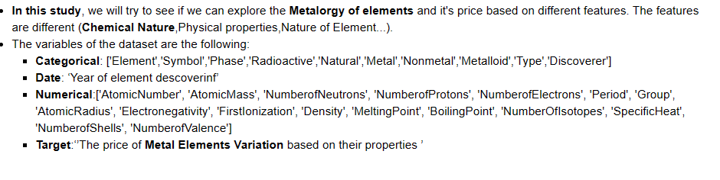
Problem Statement

Slide 12
Data Cleaning
['Metal','Nonmetal','Metalloid'] ==> is to concate as a one column with name [ChemicalNature]
We can Fill The Missing Values of Numerical Columns with==> ('0.0') & Categorical Columns with==>('undefined') Accordding To:
Lanthanides and Actinides elements are under Discovery.
Some elements exhibit changes in physical properties that affect their chemical properties.
Some elements have not been confirmed for their physical and chemical properties.
Certain elements exhibit changes in their chemical properties as a result of alterations in their physical properties. For example, when elements undergo a phase change, such as going from solid to liquid or liquid to gas, they often display differences in their chemical reactivity or behavior. One example of this is water (H2O), which remains chemically the same but exhibits different physical properties as it transitions from solid ice to liquid water to gaseous vapor.

Slide 13
Data Analysis & Visualization
1. Using pandas & Plotly
2. Using Dash app

Slide 14
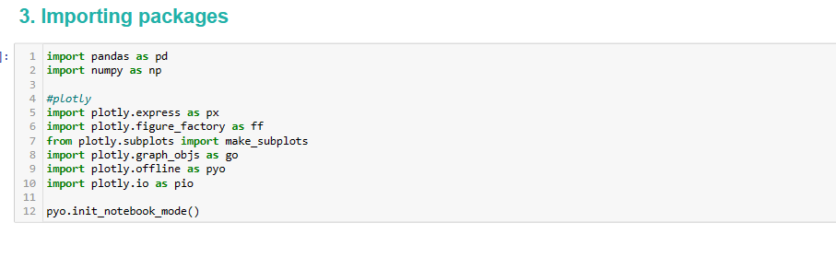
Import Packages

Slide 15
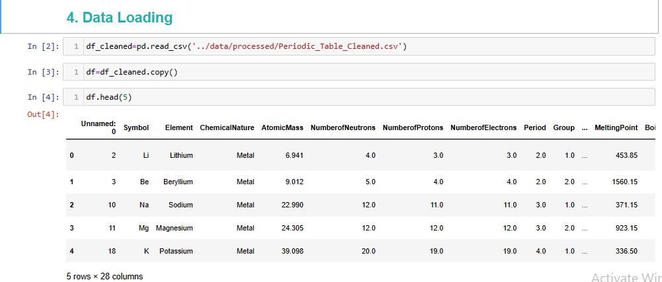
Data Loading

Slide 16
Data Analysis & visualization
Properties:
Physical Properties: [AtomicMass, Number of Neutrons, Number of Protons, Number of Electrons, Period, Group, Phase, Density, Melting Point, Boiling Point, Number Of Isotopes, Specific Heat, Number of Shells]
Chemical Nature: [Radioactive, Natural, Type, Atomic, Radius , Electro negativity, First Ionization, Number of Valence]
The distinction lies in how these properties relate to the behavior, structure, and composition of the elements. Those classified as physical properties are primarily concerned with the state of matter, mass, and energy exchange, while the chemical properties focus on atomic and molecular interactions, reactivity, and atomic structure.

Slide 17
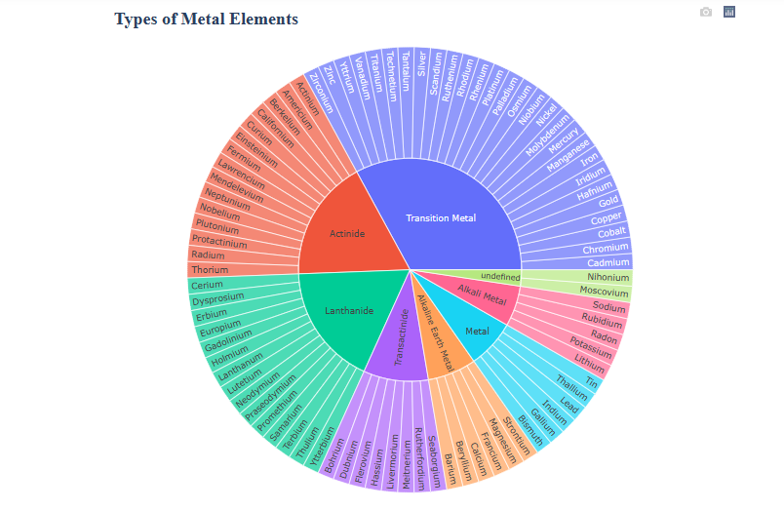

Slide 18
Type Of Elements
Transtion Metal
Alkaline Earth Metal
Alkali MEtal
center of the periodic table
enerally poor conductors of heat and electricity.
The majority of elements are metals
Actinide
Lanthinide
Transactinide
located at the bottom of the periodic table.
located at the bottom of the periodic table.
intermediate between metals and nonmetals.

Slide 19
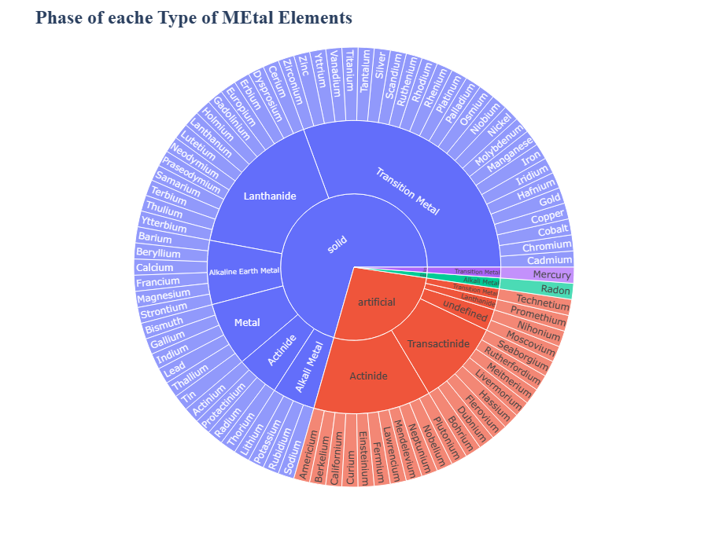

Slide 20
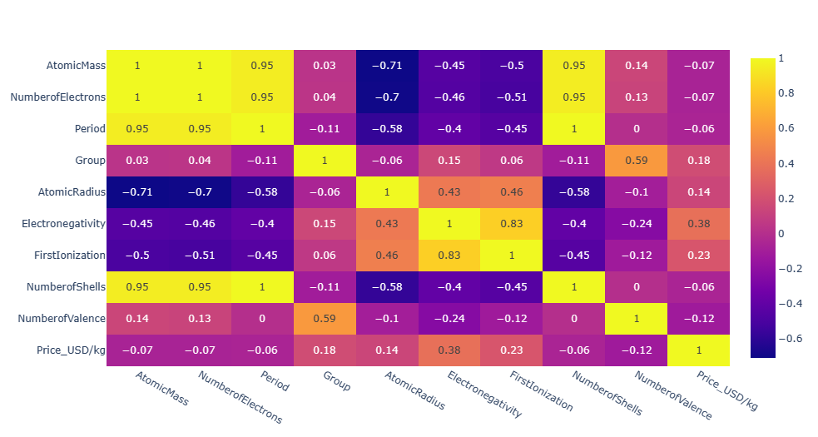
Correlation of Features
Heat Map
Report
It seems that there are a strong correlation between:
Atomic mass & [ NO.shells, Period ]
NO. Electons & [No.shells, period]
Group & NO.velance
Atomic Radius & [ElectroNegativity, First Ionization]
ElectroNegativity & First Ionization
Price & [First Ionization, ElectroNegativity, Atomic Radius, Group]

Slide 21
phases of Metal Elements
The phases of metal elements in the periodic table refer to their physical states under normal conditions of temperature and pressure. In the context of the periodic table, metals can exist in three primary phases: solid, liquid, and gas. Here are notes about each phase:
Solid Phase:
The majority of metal elements in the periodic table exist in the solid phase at room temperature.
Metals are characterized by a crystalline structure in the solid state, where atoms are closely packed in a repeating pattern, forming a metallic lattice.
Solid metals have a definite shape and volume. They are typically dense and have high melting points.
Liquid Phase:
Under certain conditions, some metals can transition from the solid phase to the liquid phase.
The temperature at which a metal transitions from solid to liquid is its melting point. Different metals have different melting points.
In the liquid phase, metals lose their rigid structure, and atoms are more mobile. This phase is less common for most metals under normal conditions.

Slide 22
phases of Metal Elements
Gas Phase:
In general, metals exist in the solid or liquid phases at room temperature, and only a few metals exist in the gaseous state under normal conditions.
The transition to the gas phase typically occurs at very high temperatures, often beyond those encountered in everyday conditions.
Some metals, such as mercury, have relatively low boiling points, allowing them to exist in the liquid phase at or near room temperature.
Special Consideration - Mercury:
Mercury (Hg) is a unique metal that remains in the liquid phase at room temperature. It has a low melting point and is the only metal that exists in liquid form under standard conditions.

Slide 23
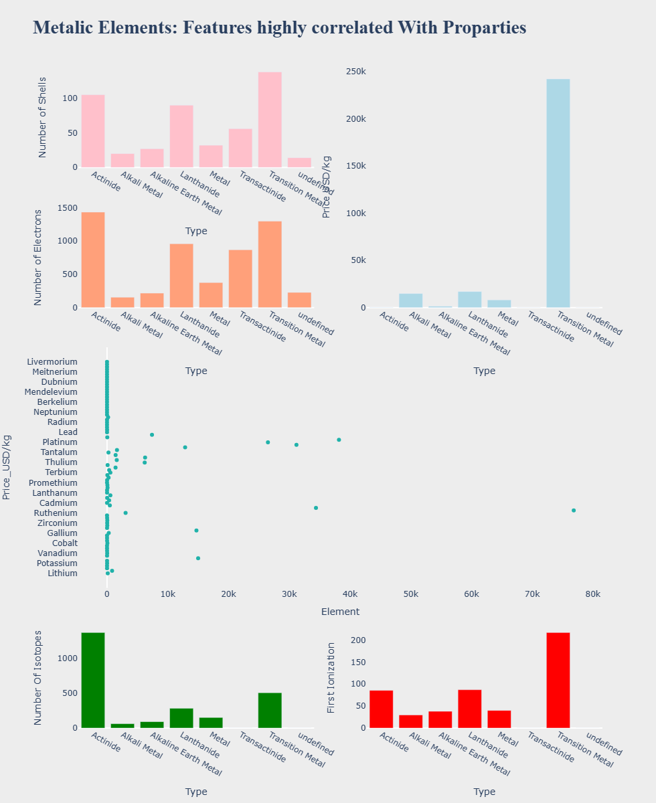

Slide 24
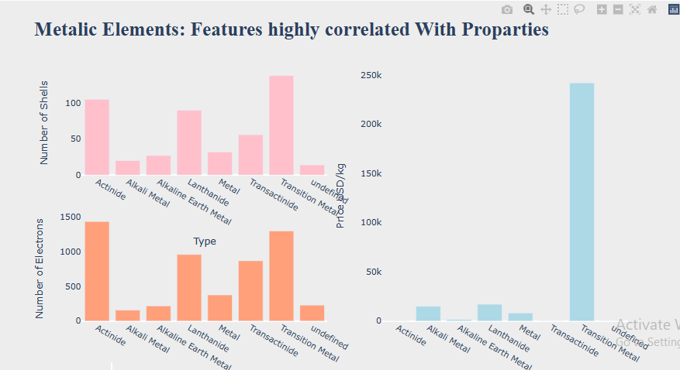

Slide 25
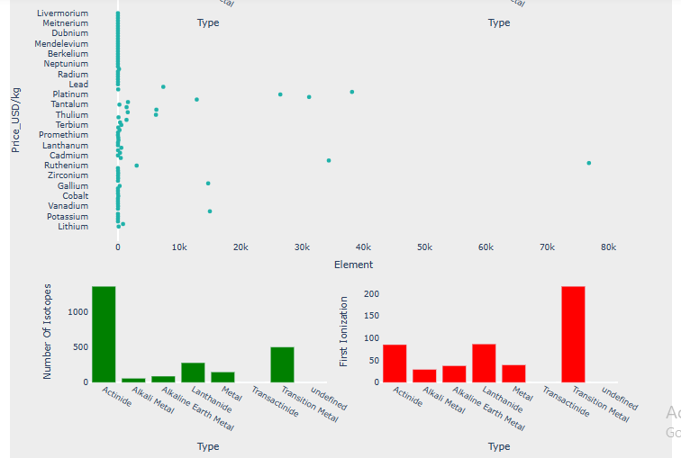

Slide 26
Type Of Element & PriceAnalysis
It seems that Transition Metals have the highest properties and therefore the highest price,Let's find out!
Metallic Elements: Features highly correlated With Properties

Slide 27
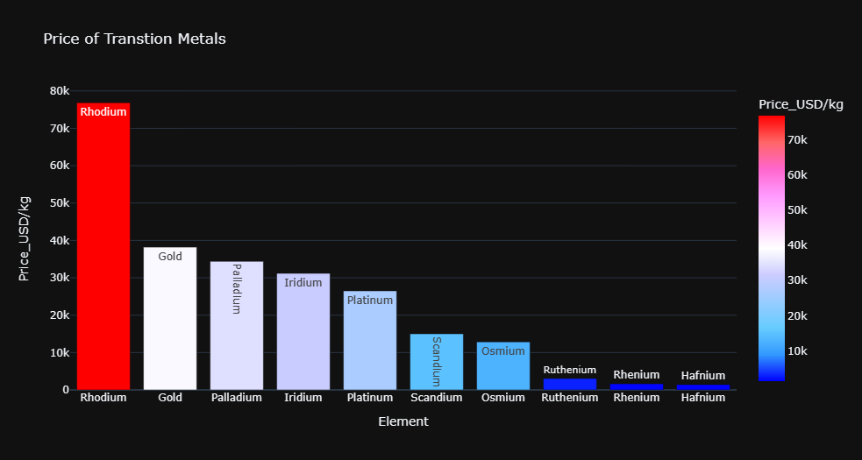

Slide 28
Price of Transition Metals
Rhodium
Gold
catalyst in various industrial processes
highly valued precious metal.
Pallidum
Iridium
is a dense and corrosion-resistant metal
precious metal with diverse industrial applications
Rhodium
Gold
Rhodium prices can be volatile, and it is one of the most valuable precious
widely used in jewelry and electronics.
90%
75%

Slide 29
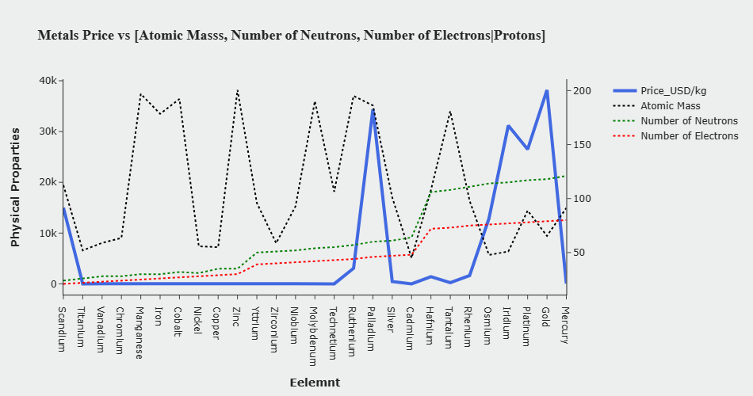
Metals Price vs [Atomic Mass, Number of Neutrons, Number of Electrons|Protons]
Atomic Mass
NO.Neutrons
NO.Electrons
Price

Slide 30
Metals Price vs [Atomic Mass, Number of Neutrons, Number of Electrons|Protons]
Atomic Mass: There may be some correlation between the atomic mass of a metal and its price, but it's not a strict rule. Some heavy metals may be more valuable due to their scarcity or specific applications.
Number of Neutrons, Number of Electrons/Protons: These properties are more intrinsic to the metal's composition. Changes in these values might affect the metal's stability and behavior in reactions, but their direct impact on price could be indirect.

Slide 31
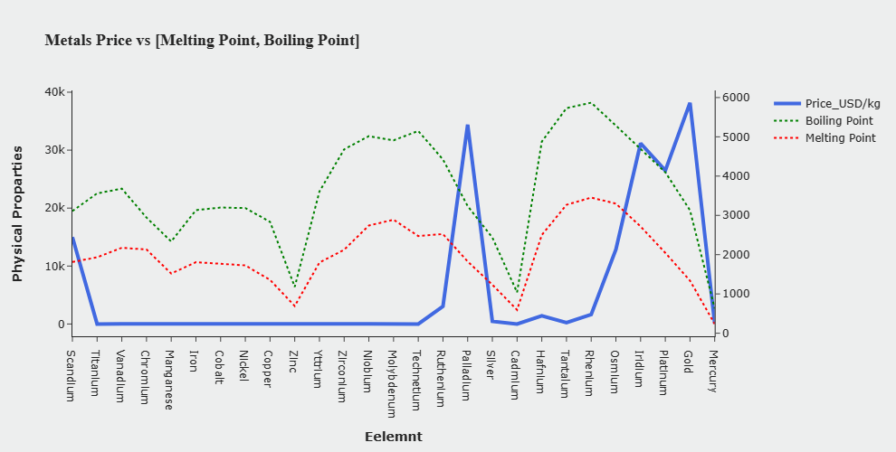
Metals Price vs [Melting Point, Boiling Point]

Slide 32
Metals Price vs [Melting Point, Boiling Point]
Melting Point, Boiling Point: These properties are related to the metal's phase transition from solid to liquid and liquid to gas, respectively. While there might be some influence on price (e.g., high melting points in metals used in high-temperature applications), it's not the primary determinant.

Slide 33
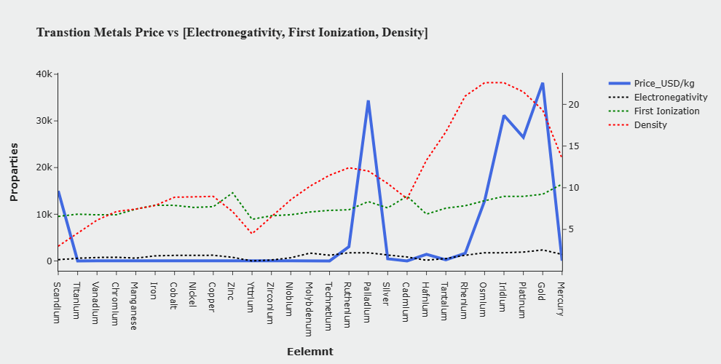
Transition Metals Price vs [Electronegativity, First Ionization, Density]

Slide 34
Transition Metals Price vs [Electronegativity, First Ionization, Density]
Electronegativity: Transition metals generally have moderate electronegativity values. The price might be influenced by their reactivity and use in various applications, but a direct correlation may not be straightforward.
First Ionization: The energy required to remove the first electron. Transition metals may exhibit variable ionization energies. The relationship with price is likely indirect and influenced by factors like reactivity and demand.
Density: Transition metals often have high densities. This can impact their applications, but it might not be a primary factor in determining price.

Slide 35
Periodic Table Dash APP
1.Bibble chart
2.Bar Chart

Slide 36
Periodic Table Dash App
Bubble Chart to show Distribution of Elements Price
Bar Chart to show Properties of elements

